Slide 1

Power BI One Day Course
Power BI is a cloud based data analytics tool
Level: Basic and Intermediate
Target Audience: Anyone who has an interest in creating incisive reports using Power BI
Last Updated: 29/08/2023

Slide 2
About the Speaker: Kieran Wood
https://www.linkedin.com/in/kieranpatrickwood/
Consultant, Developer, Architect, Trainer and Publisher @ Innovative Business Intelligence Ltd
25 Years experience in Data Management and Analytics
Power BI Author, trainer and public speaker
22K+ followers on LinkedIn
Passed 18+ Microsoft Data focused exams

Slide 3
Introduction
This is a two day Power BI course condensed into one day which is based on the following book https://www.amazon.com/Data-Analytics-All-Power-Commercial-ebook/dp/B0821V8R15
So this course will consist of exploring and amending the book solution to meet the agreed course objectives … https://community.fabric.microsoft.com/t5/Data-Stories-Gallery/Power-BI-Best-Practice-Recommendation/m-p/745072#M2786

Slide 4

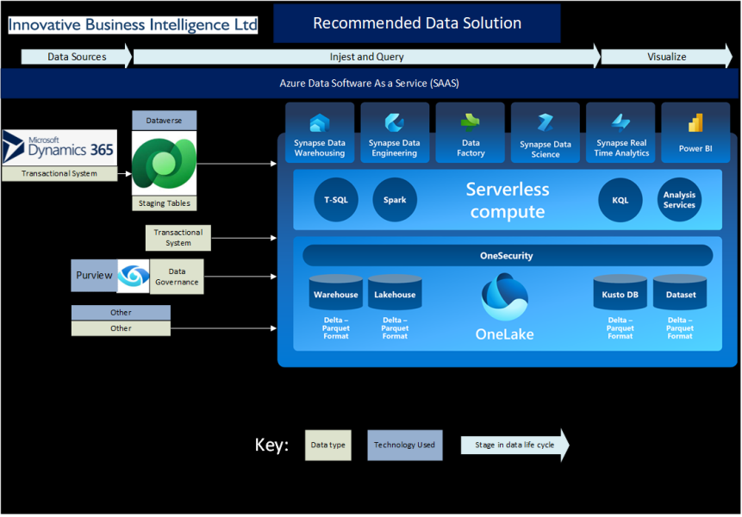
Microsoft Fabric

Slide 5
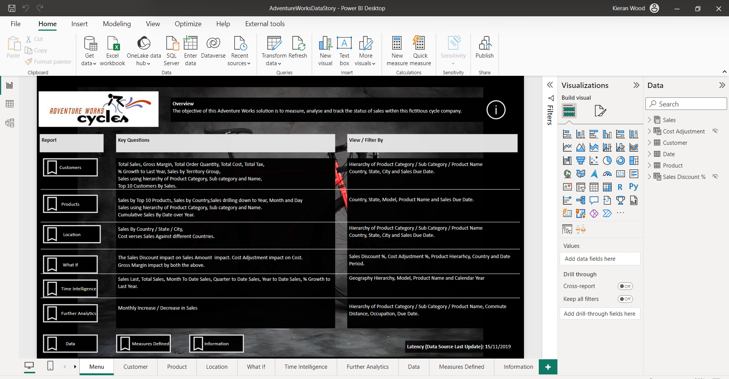
Get the Solution Running within Power BI Desktop

Slide 6
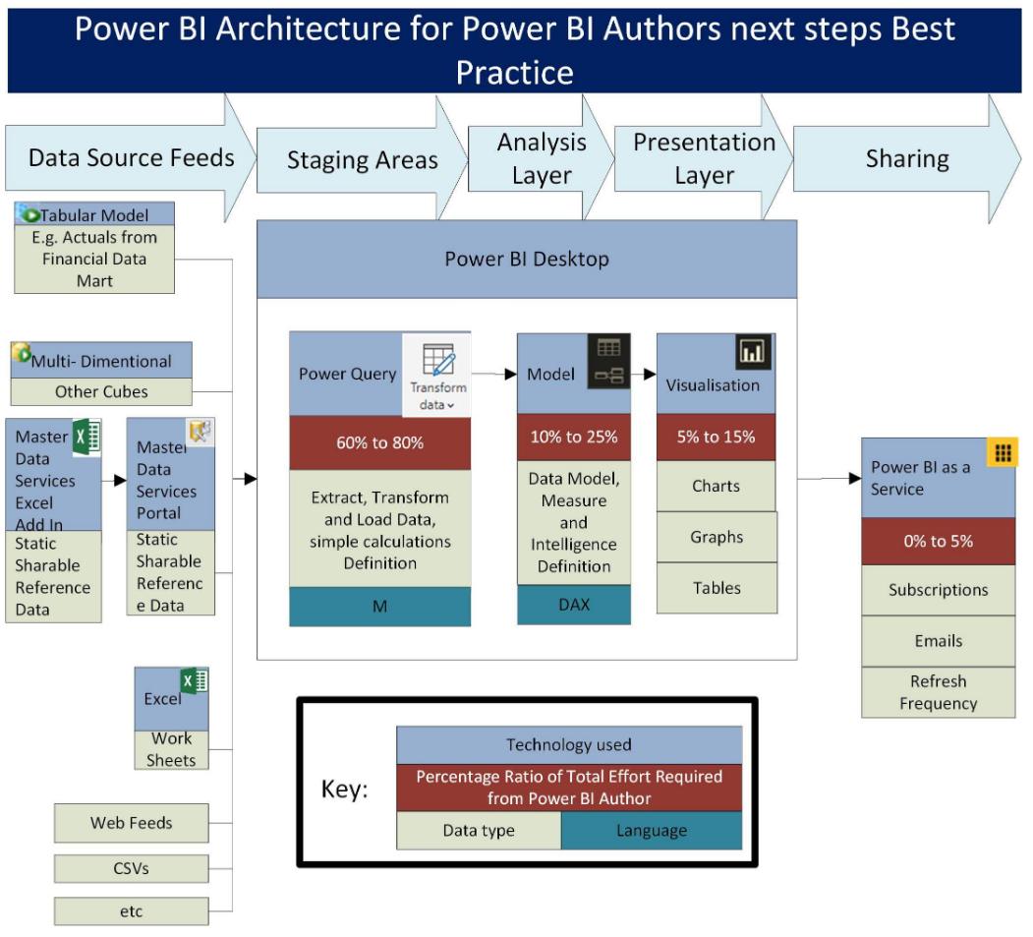

Slide 7
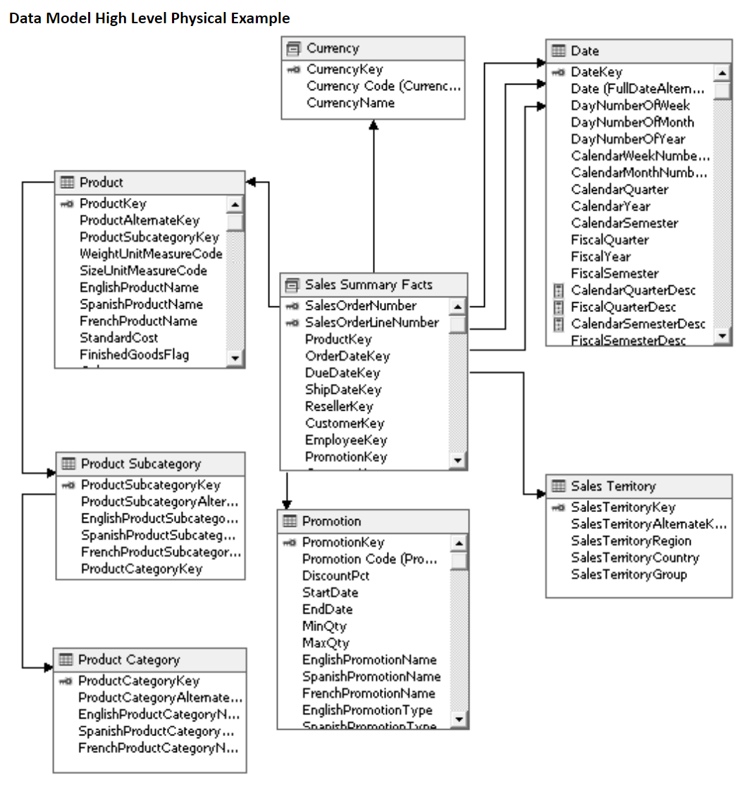

Slide 8
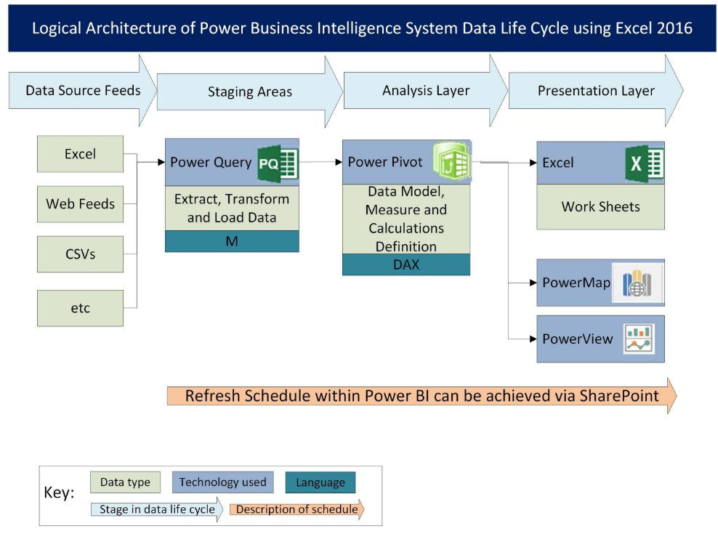

Slide 9
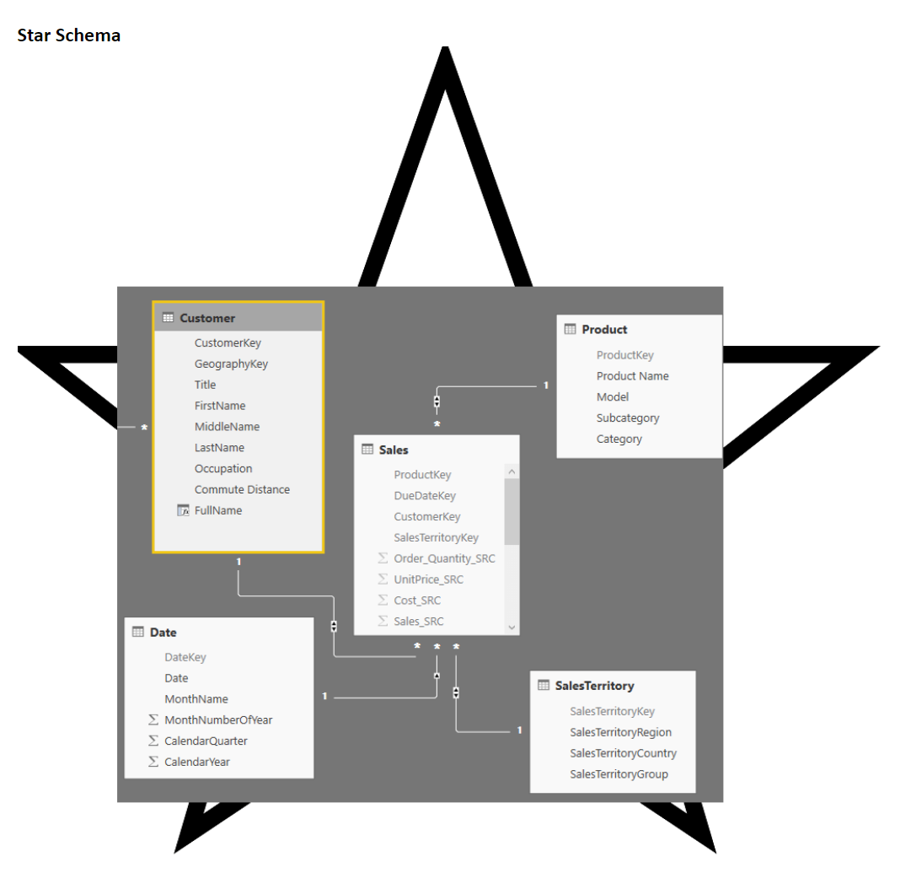

Slide 11
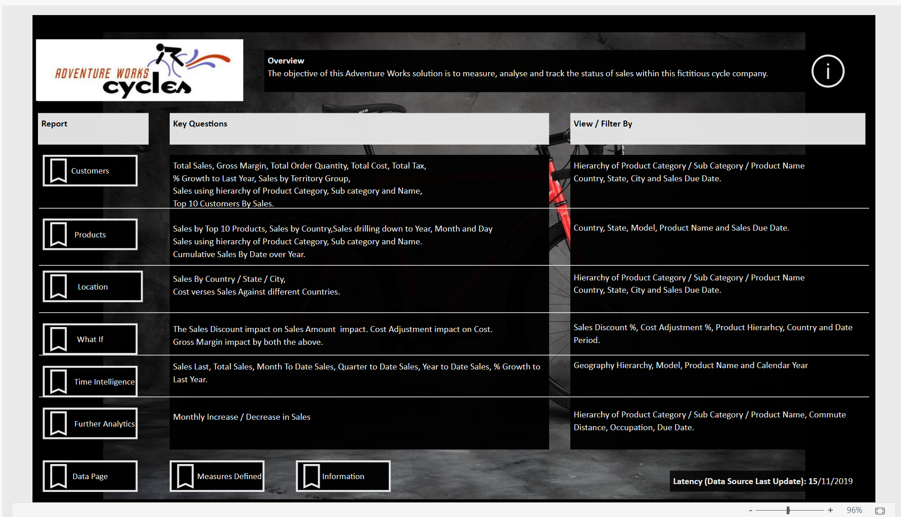
Navigate the Sample Solution

Slide 12
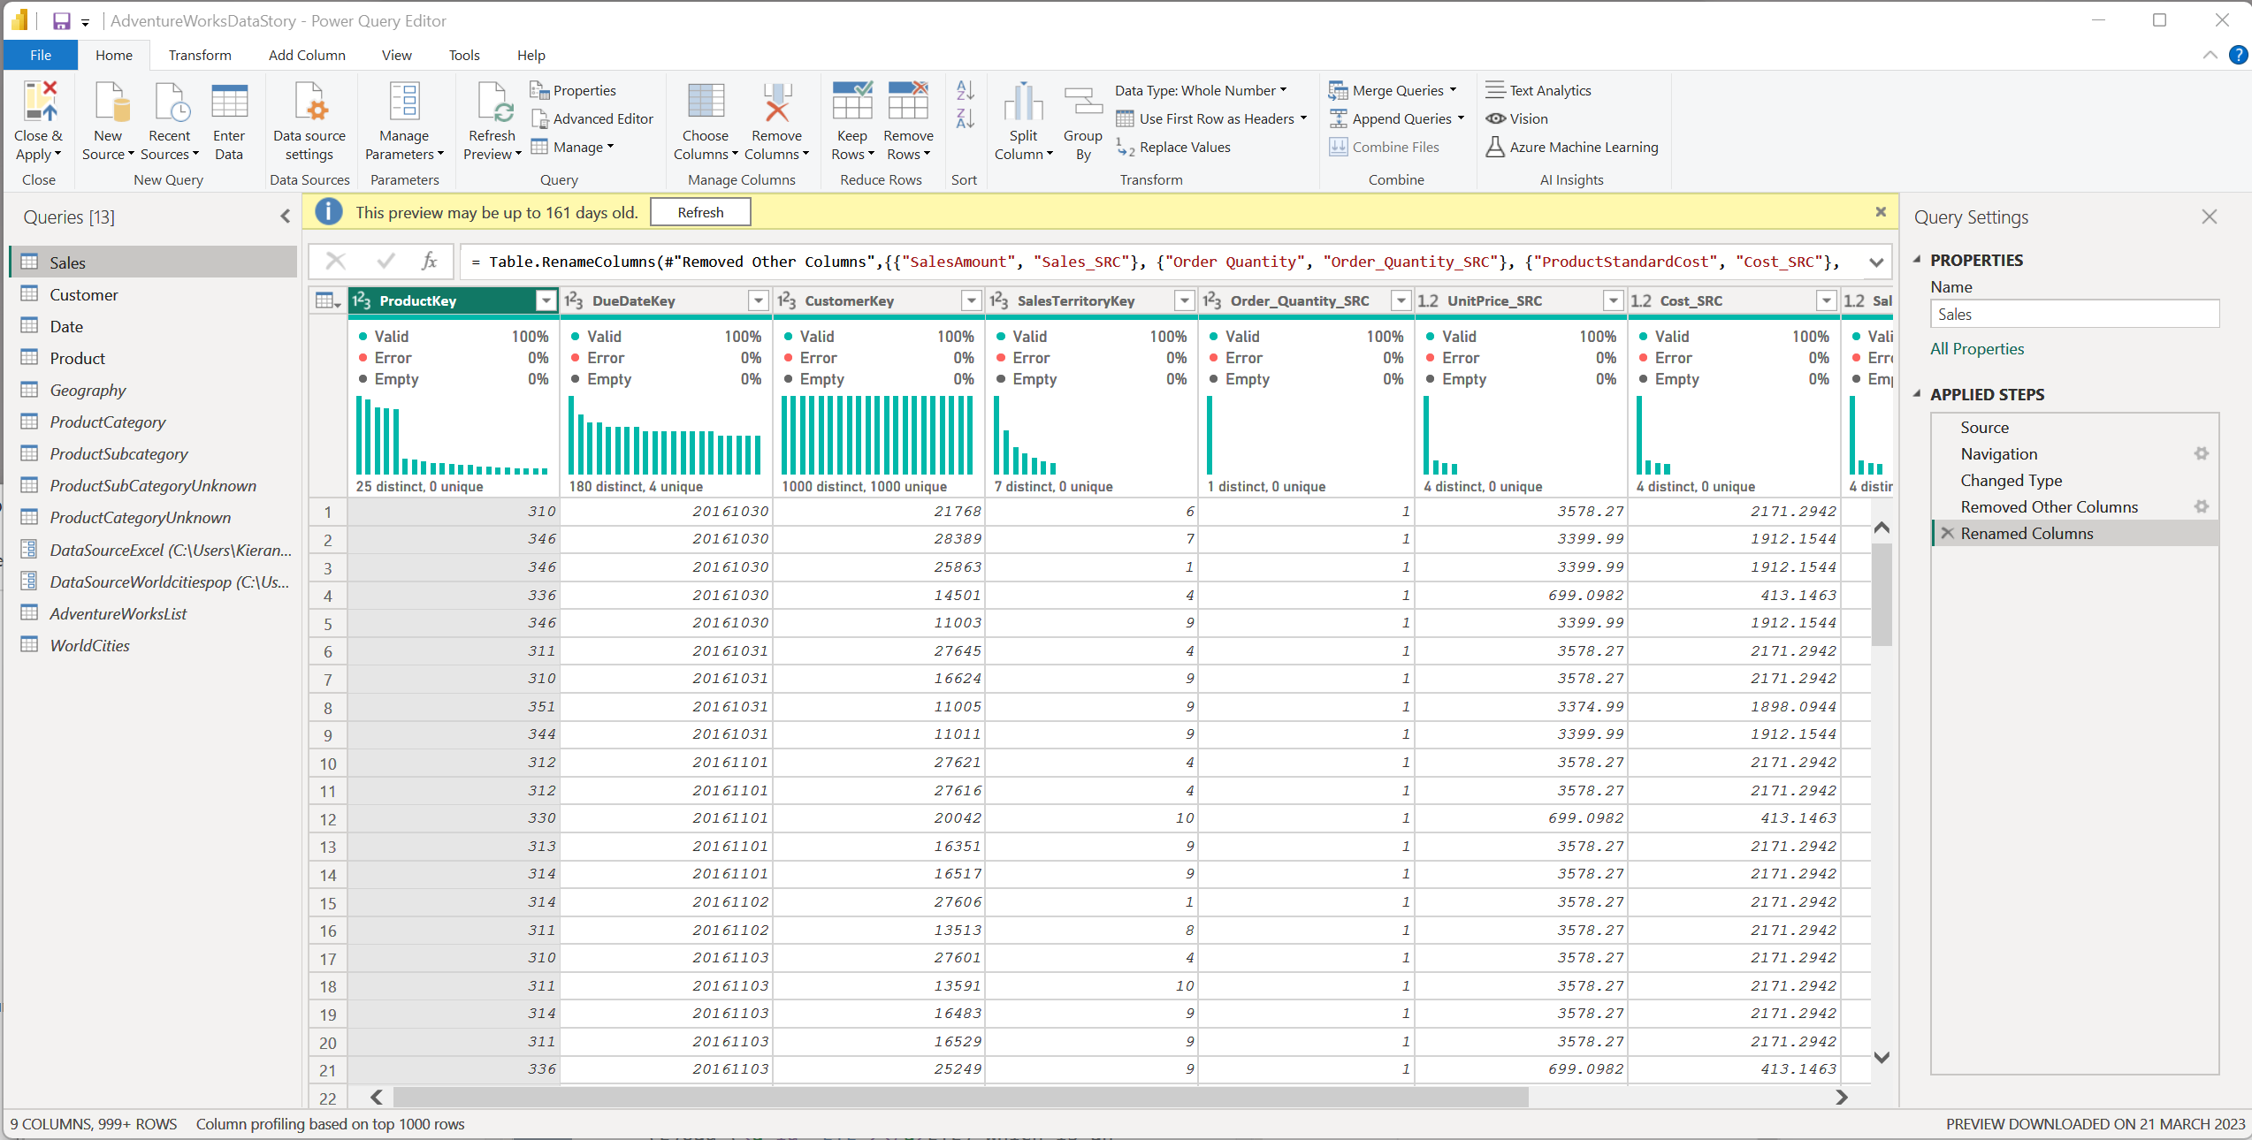
Power Query for Extract, Transform and Load
Notes:
Module 4: Manually Cleaning By Inspection: Data Cleansing: Joins to replace VLOOKUP: Importing data from A worksheet, Excel File, CSV file, Database, Web Page

Slide 13
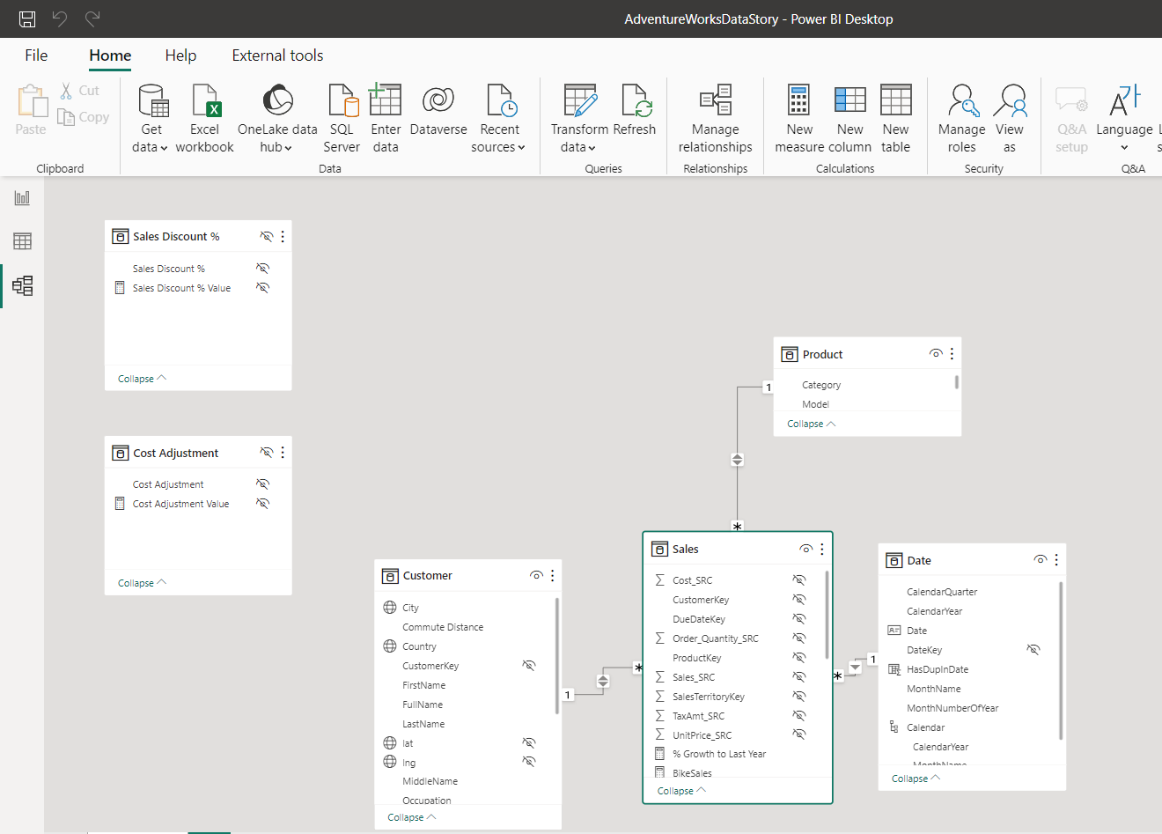
Data Model
Notes:
Module 10: Arrange Formula Alternative to SUMIFS() which is DAX Calculate

Slide 14
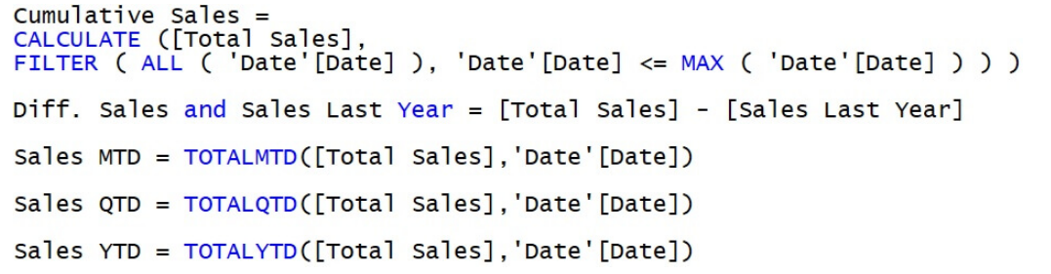
Measures
Notes:
Module 10: Rank Values, Measure formatting

Slide 15
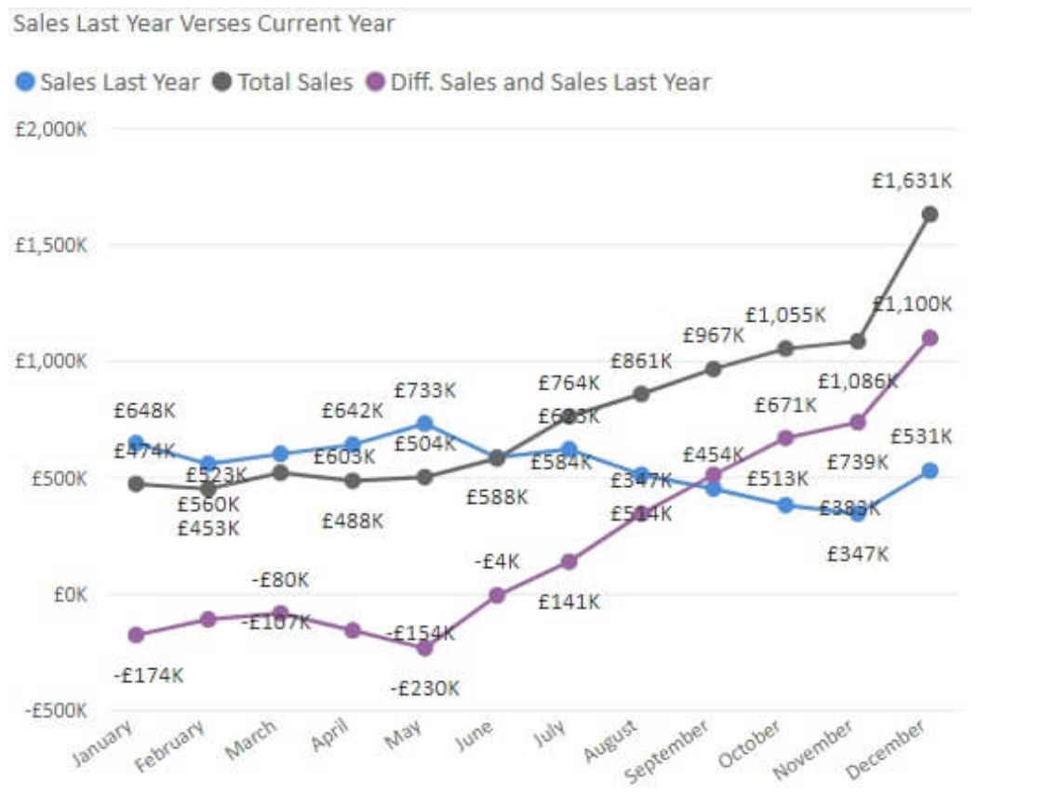
Data Visualisations
Notes:
Module 7: Interactive Controls: Form Controls Introduction: Check Boxes, List Boxes, Option Buttons, Group Boxes, Scroll Bar, Buttons, Combo Boxes

Slide 16
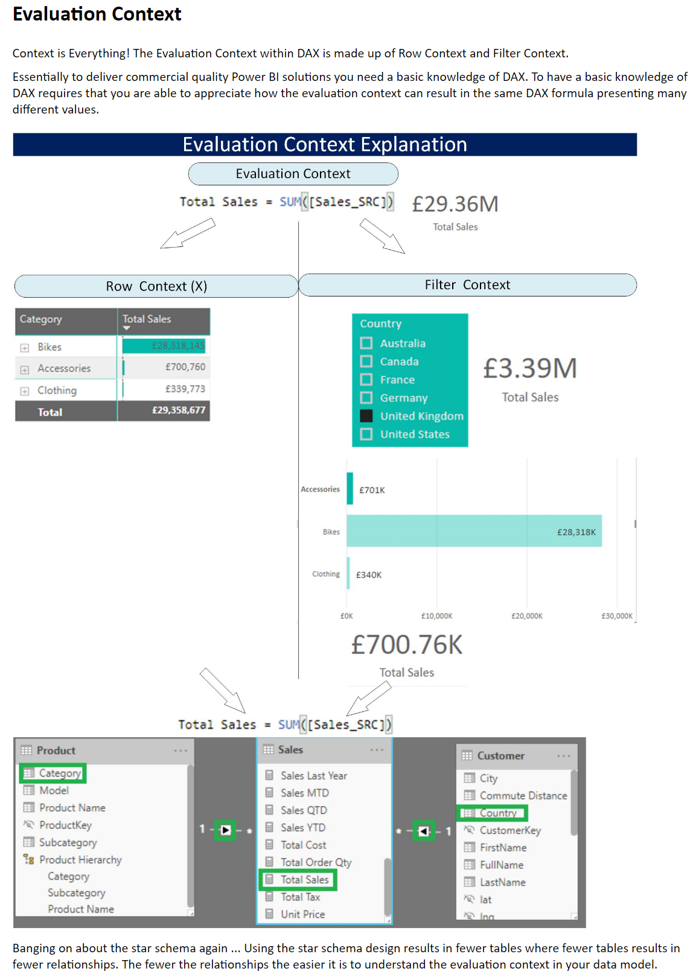

Slide 17
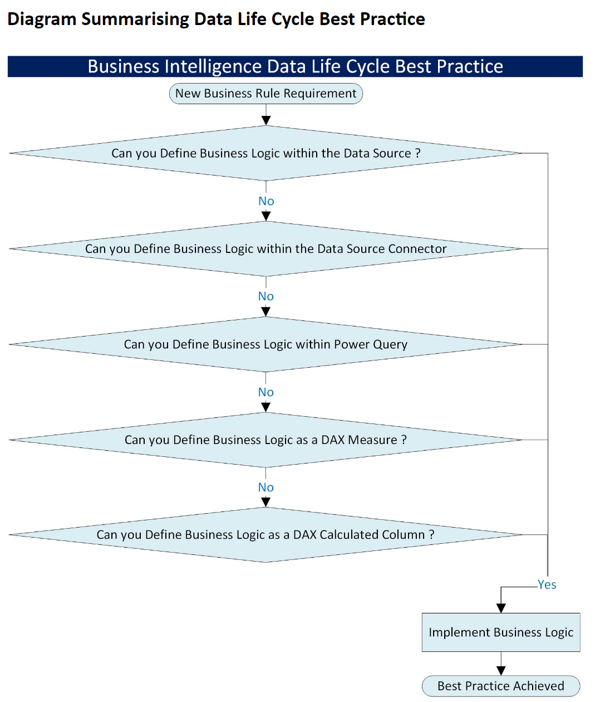

Slide 18
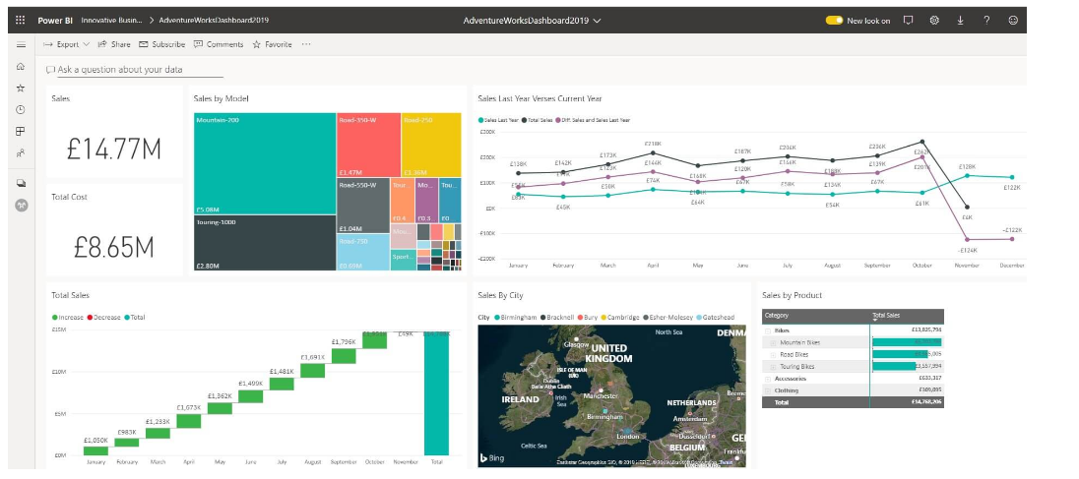
Power BI Service
Notes:
Module 9: Incorporating New Data Automatically, Auto Refresh Visuals Including Tables

Slide 19
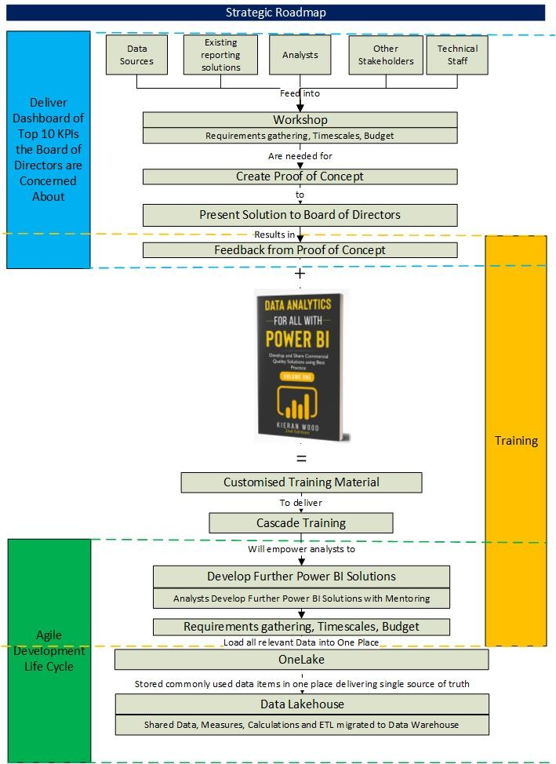

Slide 20
Finish
Thank you
Please connect to me on LinkedIn … https://www.linkedin.com/in/kieranpatrickwood/
Review and click the like button on the article …
https://www.linkedin.com/pulse/journey-towards-microsoft-fabric-kieran-wood

